Slide 1
Paris
Adam Senaj 7.A

Slide 2
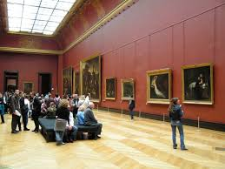
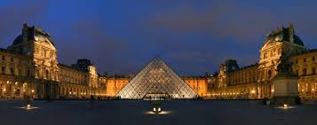
Museum Louver
Museum in the palace Louver is the most visiting art museum on the world.
The museum started to be used in 1793.
There is the most famous painting from Leonardo da Vinci and it calls Mona Lisa.

Slide 3
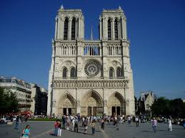
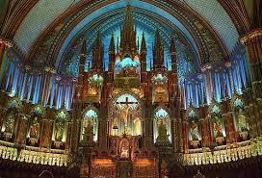
The catedral Notre Dam
While the catedral Notre Dam becoming the most founding showpalce it lived a lots of centurys and it lived a lots of humans tragedies.
People started build it at a half of the twelve century in the oldest part of Paris ille de la cité

Slide 4
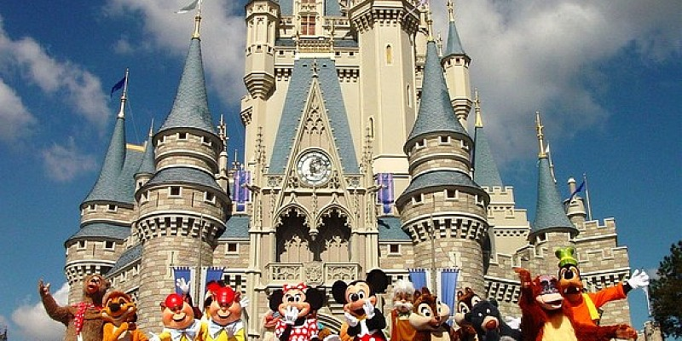
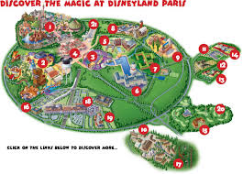
Disneyland Paris
Paradise for children and nightmar of purse of parents is part of Paris from 1992. When on the edge city created huge zone of fun and children laught .
Funny park EuroDisneland is the first Disneyland in Europe. And you can take a photo with characters from disney s movies and comics.

Slide 5
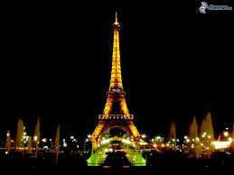
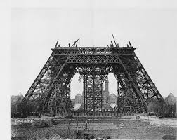
Eiffel tower
Once of the symbols Paris and his irredeemable panorama is 324 metres long Iron Mrs.
She is on the left shore of river Seina on Champ d Mars.
And it include to the most popular attraction in the city.

Slide 6
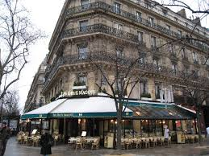
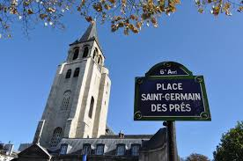
Saint-Germain-des-Prés
Saint Germain Des Prés is on the left shore of river Seina and formally it is sixths Paris ward .
This region is in the city bounded with Luxemburg garden s , Latin district and Eiffel tower. Saint-Germain-des-Prés was once bastio for artist. Beetween the most interesting attraction here include Luxemburg s gardens.

Slide 7
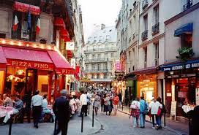
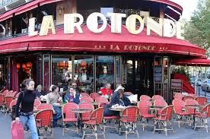
Latin district
Latin district is region of Paris contained from once part in 5.th district and second part is in the 6.th district in city. Latin district is on left shore of the river Seina near crossroad two famous Paris aveneus Boulevard St. Germain a Boulevard St.Michel.

Slide 8
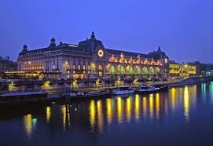
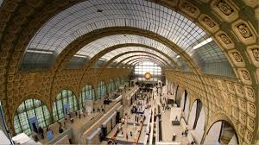
Museum Orsay
Museum Orsay is one of the most famous museum on the left shore of river Seina.
The home of museum is beautifull building used to train station Gare d’Orsay people built this building beetween 1898 and 1900 in the Beaux Arts style

Slide 9
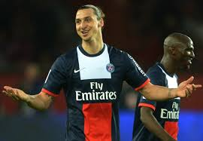
PSG – Paris Saint Germain
PSG is the most famous football club in Paris it won the Ligue 1 4 times and I think they win the league this year too.Because they are the best team in France .They are playing on Parc De Princes . Their best player is Zlatan Ibrahimovič.

Slide 10
Thanks for watching

